Slide 1


Heritability of Pinyon Pine Stomata
By: Tara Llewellyn and Dr. Amy Whipple
Northern Arizona University

Slide 2
Brief Overview
Introduction
  - Background Information
  - Hypothesis
Methods and Materials
- Cone collection and genetic testing
- Visionary Digital BK-Plus Imaging System
- Image J program
Results
Conclusion

Slide 3
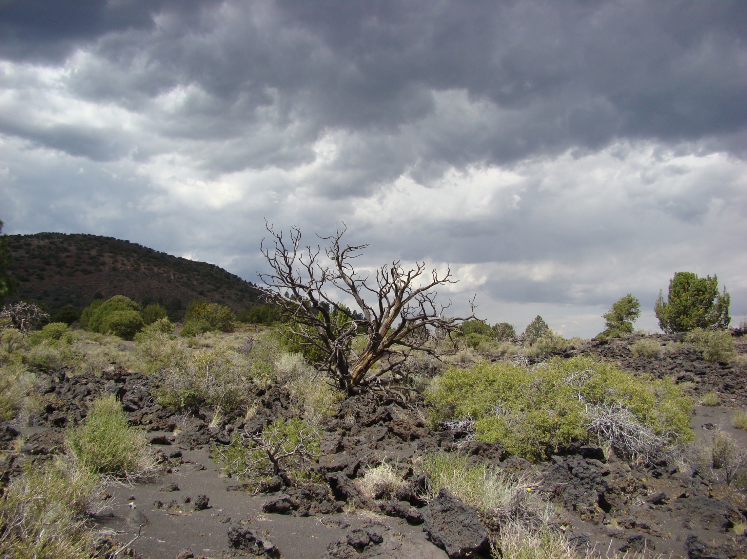
Introduction
Climate change – limits already scarce water resources.
Natural selection – to create new populations.
Heritability - variation in a particular trait that can be attributed to inherited genetic factors.
Notes:
trait

Slide 4
Pinyon Pine trees may adjust by altering their stomata traits.
CO2
H2O

Slide 5
Hypothesis
There will be a correlation between the offspring's and their parent’s stomata measurements.
A significant relationship between the trait of the parents and the offspring suggest the trait is heritable.
If the trait is heritable it can evolve in response to natural selection for increased water use efficiency under climate change.

Slide 6
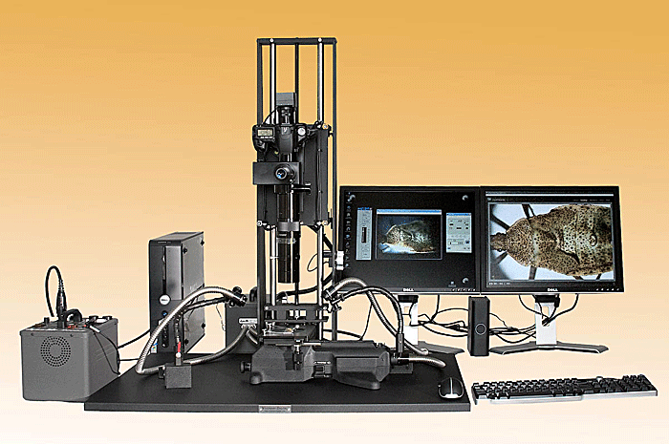
Methods and Materials
Cones were collected to determine the mother and genetic testing was done to determine the father.
After the parents were identified, samples of needles were collected to be used for the Visionary Digital Imaging System.
*Picture from Visionary Digital Inc.

Slide 7
Example 1:

Slide 8
Example 2:

Slide 9
Image J
To measure the average stomata area, a computer program was used.
Image J is a free Java-based image processing program.
Each image was cropped and then analyzed.

Slide 10
Results
Equation of the line: y = 0.39x+104
P value = 0.0031

Slide 11
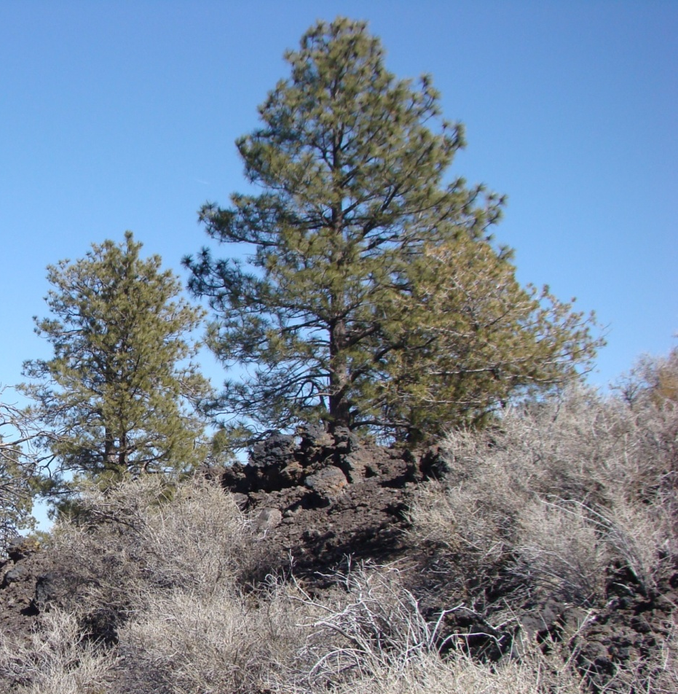
Conclusion
We conclude that stomata traits such as surface area are heritable and that these traits are expected to evolve from natural selection.

Slide 12
Acknowledgements:
The Arizona Space Grant Consortium
Nadine Barlow and Kathleen Stigmon
Dr. Amy Whipple
The Pinyon Pine Research Group
Neil Cobb and the Biology Department

